Slide 1
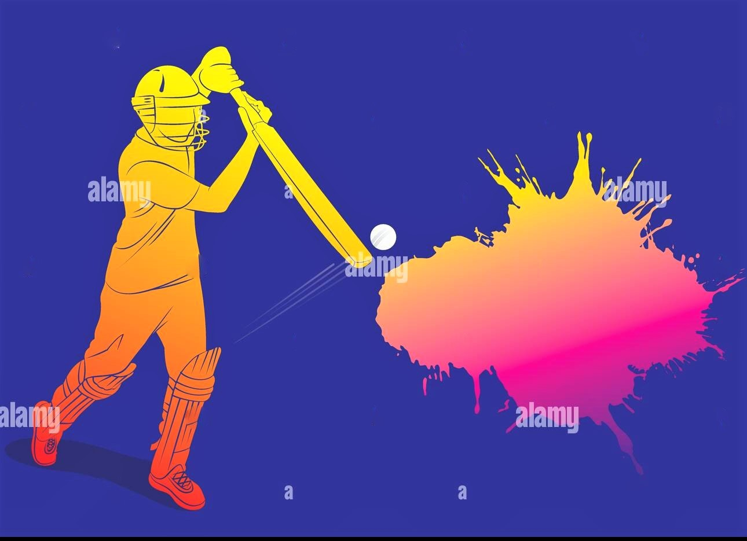
CRICKET MANAGER
MADE BY: ARUNIM CHAKRABORTY 07
KSHITIJ SHIDORE 51
SIDDHANT DONGRE 12
RUPESH DHIRWANI 10

Slide 2
HOW THE USER PLAYS THE GAME
Batting
Bowling
User selects which batsman comes into bat at which position
User selects which bowler bowls which over
User selects batsman aggression
User selects field and Line and Length of bowler

Slide 3
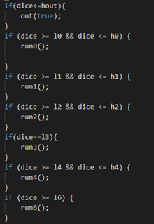
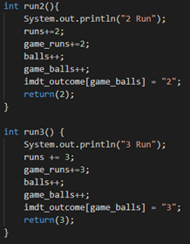
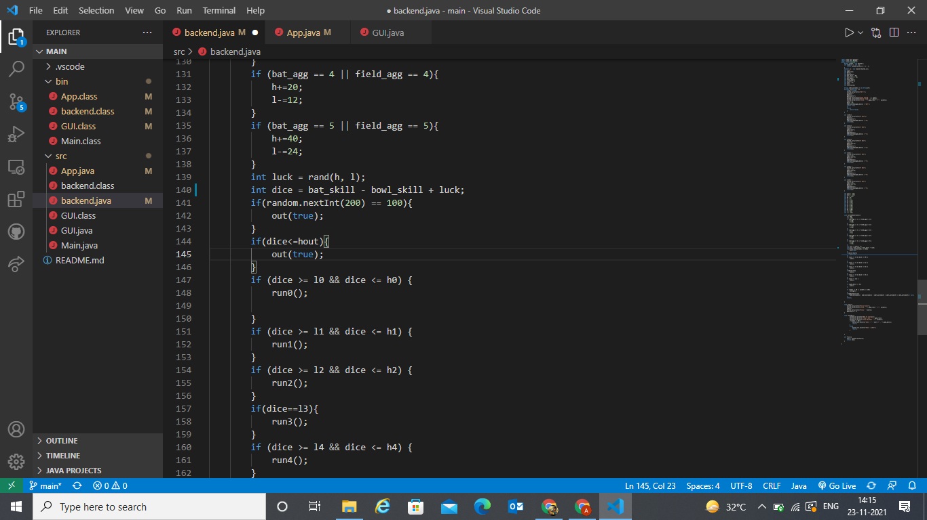
HOW DOES THE GAME WORKS IN THE BACKEND

Slide 4
HOW WILL SKILLS BE DETERMINED
Batsman
Bowler
Stroke Play/ Basic Skill
Accuracy
Against Pace/Spin
Pacer – Swing Spinner - Drift
Front Foot/ Back Foot
Pacer – Seam Spinner – Spin
Onside/ Offside
Variations – Ability to outfox the batsman

Slide 5
HOW WILL THE AI WORK
When User is Batting
When User is Bowling
AI assesses the number of overs in an innings and sets field accordingly
Selects Which batsman will come to bat at a certain position
AI assesses batsman's strength and adjusts field and Line and Length of Bowler accordingly
Set aggression of batsman in accordance with the opposition and the target if batting second
AI reads weather a given bowler has been bowling form in the game and sets bowling changes accordingly

Slide 6
Points=Profit/Weight
Where Profit=Bowlers skill
Bowler takes wicket: Weight decrease , Points increase
Bowler concedes runs: Weight increase , Points decrease
Bowler completes overs: Weight increase , Points decrease
Powerplay/Death overs: Fast bowlers weight decrease , Points increase

Slide 7
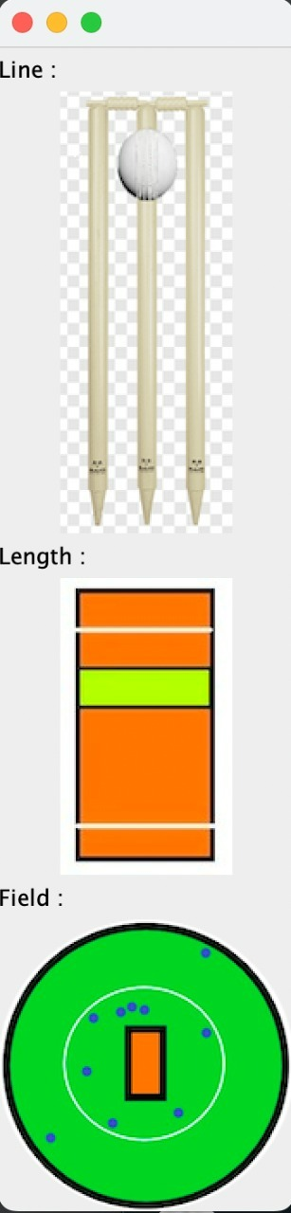
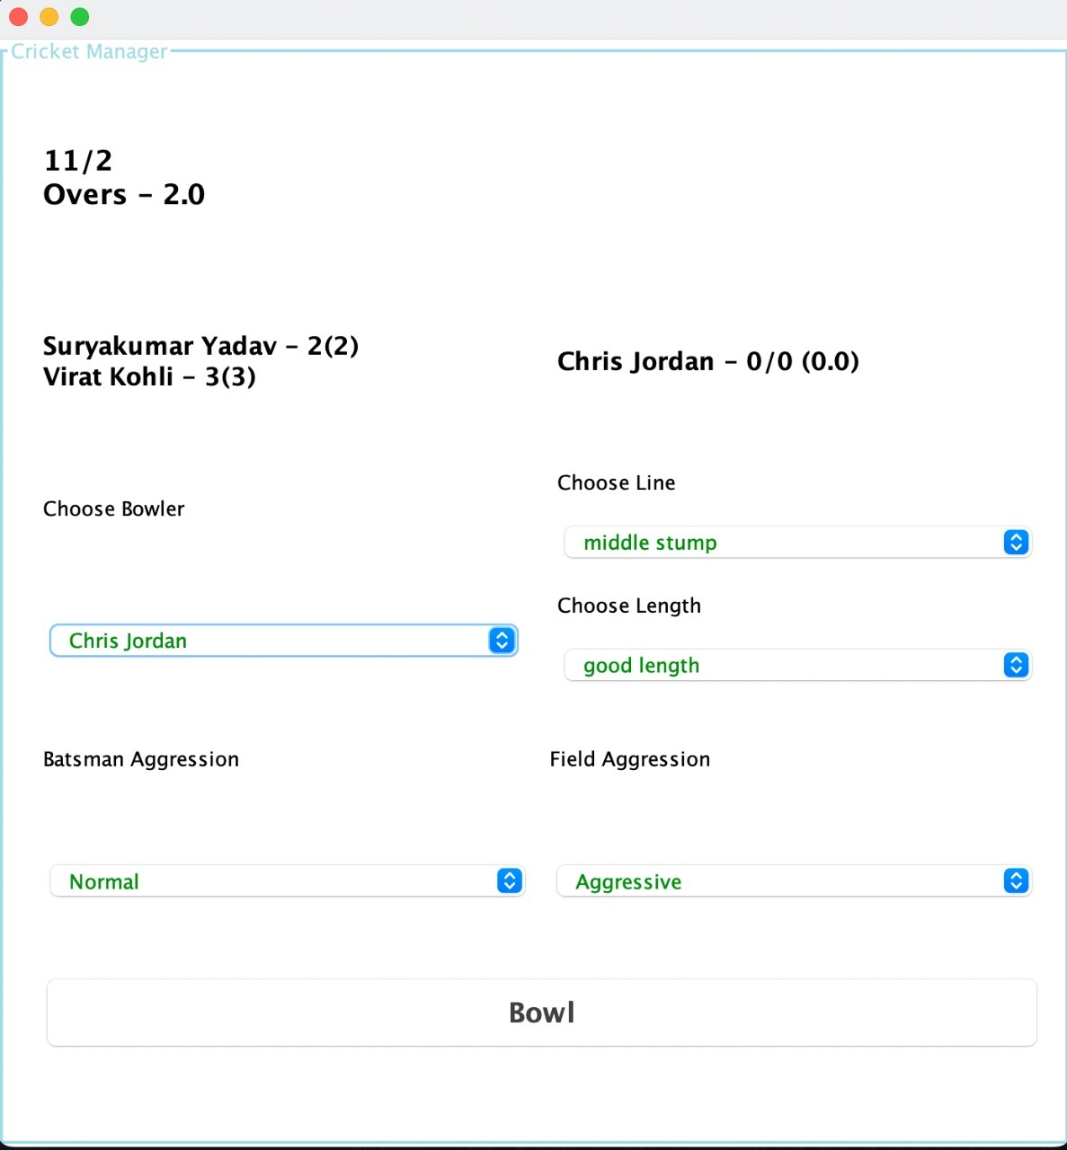

Slide 8
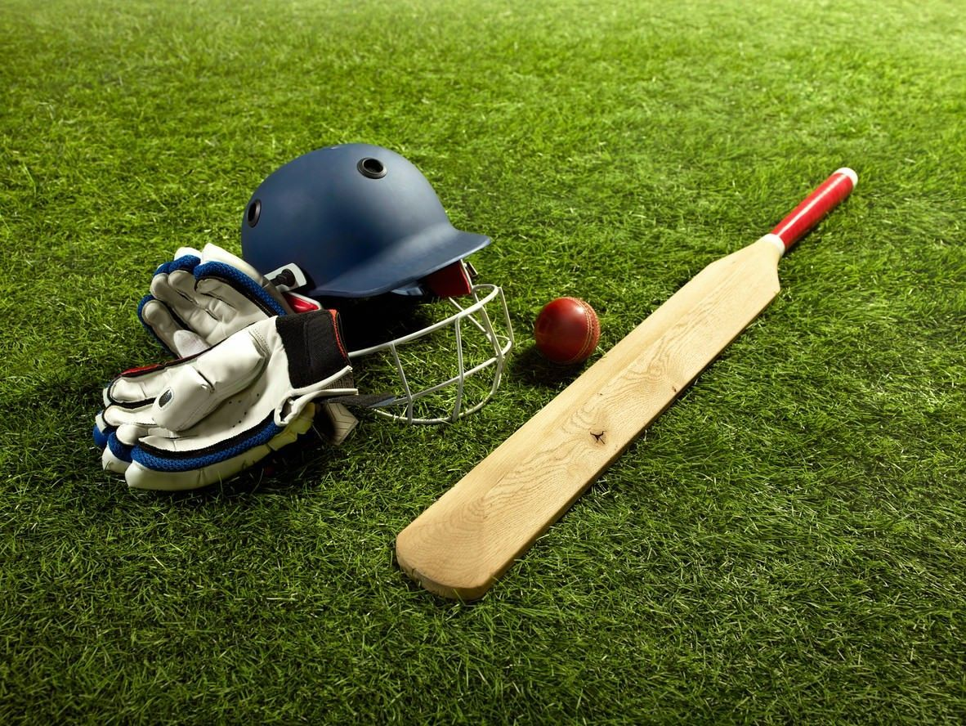
THANK YOU
THE END

